Slide 1
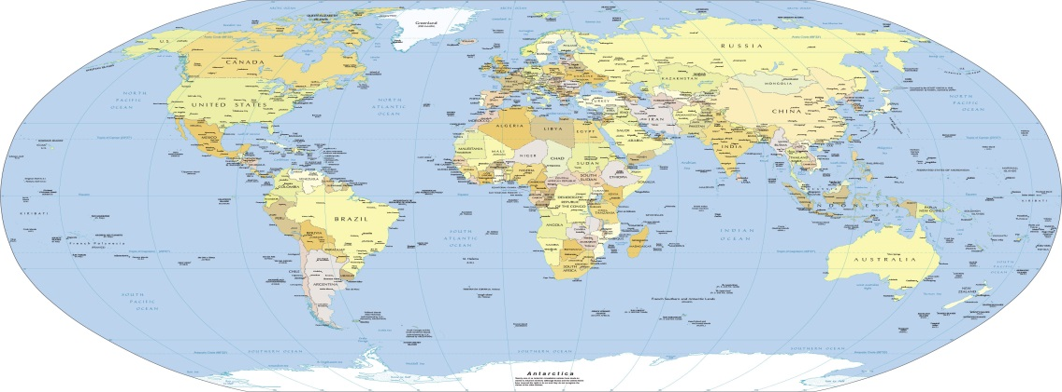

How to Locate Transportation Service Provider (TSP) Contact Information
25 Jan 2024

Slide 2
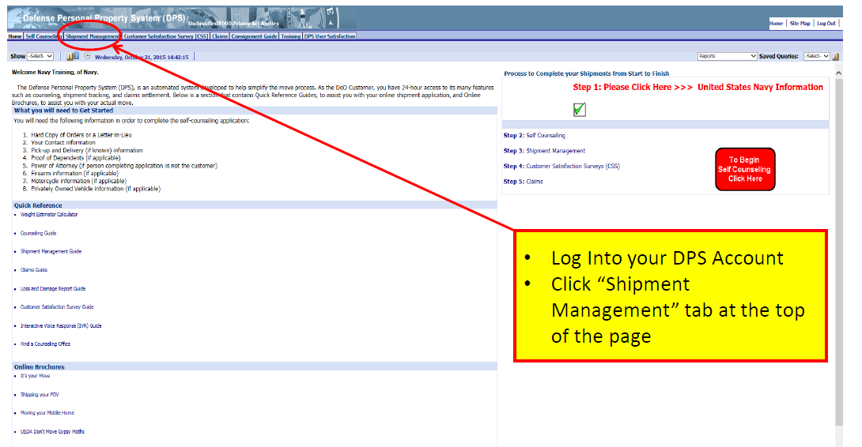
Shipment Management

Slide 3
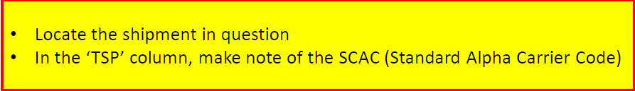
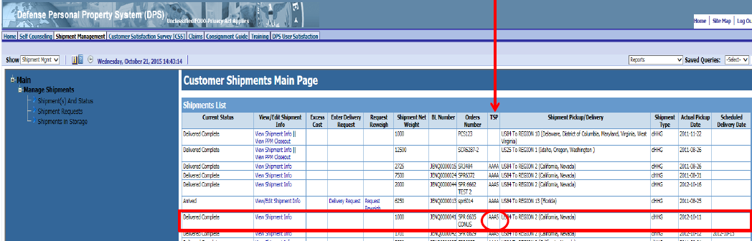

Slide 4

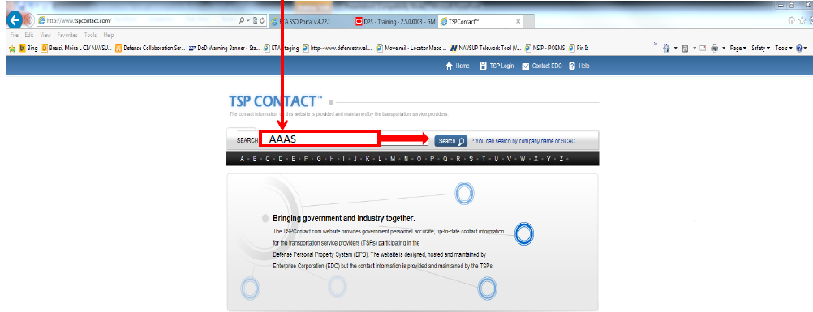

Slide 5
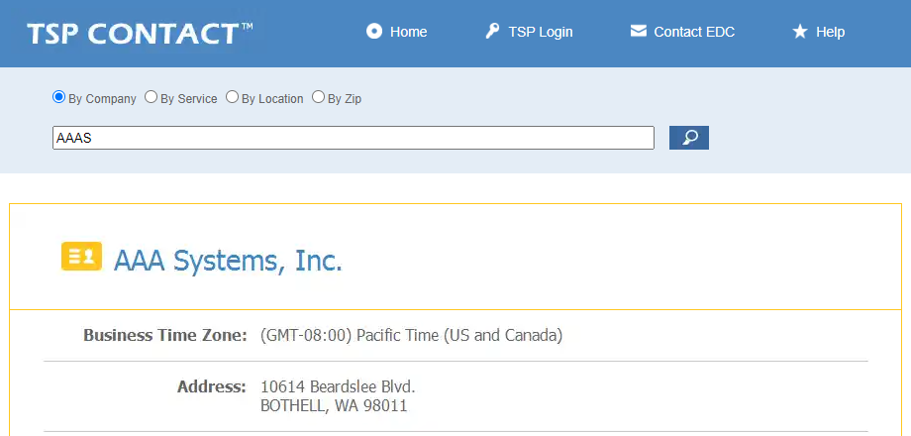
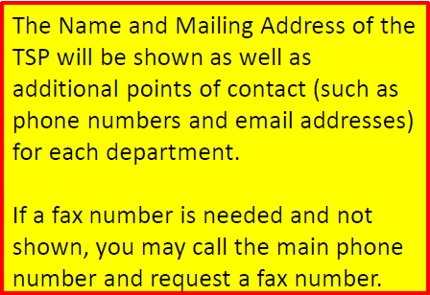

Slide 6

RESOURCES
NAVSUP Household Goods Webpage: www.navsup.navy.mil/NAVSUP-Household-Goods/Home/
DPS login: https://dps.move.mil/cust/standard/user/home.xhtml
PCS and Moving Information:
www.militaryonesource.mil/moving-housing/moving/pcs-and-military-moves
Personal Property Office Locator: https://installations.militaryonesource.mil/view-all
“It’s Your Move” booklet (Military): https://www.ustranscom.mil/dtr/part-iv/dtr_part_iv_app_k_1.pdf
“It’s Your Move” booklet (Civilian): https://www.ustranscom.mil/dtr/part-iv/dtr_part_iv_app_k_2.pdf

Slide 7

Thank You…….
We hope you have found this information helpful.

